Slide 1
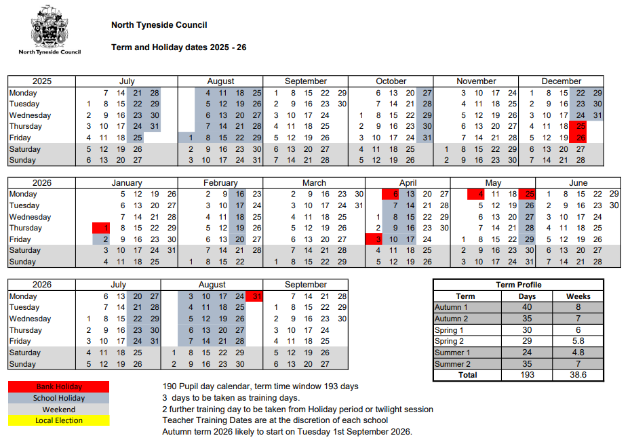

North Tyneside Term Dates 2025-26
Our training days are:
Monday 1st September
Monday 5th January
Monday 1st June
Please note there are 3 training
days this year for all schools.
Attendance
Matters
At
Fordley
Primary
School

